Slide 1

MDSD - Java development

Slide 2

Introduction
MDSD - Android
The main goal of this module is to overview some basic concepts of the Object Oriented Programming (OOP) paradigm, specifically relating to Java. This brief summary will refresh some ideas which will be extremely important to understand and to get an insight of the Android platform.
Notes:
Welcome back!
Ready for the second day of the Lean IT Foundation
Check if the students are ready to start

Slide 3
Table of contents
MDSD - Android
Introduction to OOP
Why Java?
Java basics
Java syntax foundations
Java methods and classes
The Java 4: Abstraction, Encapsulation, Inheritance and Polymorphism
Java stream manipulation
Review of learning aspects
Notes:
Welcome back!
Ready for the second day of the Lean IT Foundation
Check if the students are ready to start

Slide 4
Introduction to OOP
Name of the program
There are two main groups* when it comes to programming languages:
Functional/procedural programming. the program is a list of instructions to the computer.
Object-oriented programming. the program is composed of a collection objects that communicate with each other.
Both approaches may be valid to solve a problem, but pros and cons arise. Regarding OOP:
PROS
It is easier to debug and to maintain.
It is a better approach when things get too complex.
It is more “realistic”, in the sense it better represents reality.
If the code is neat and well commented, it is more collaborative-friendly. Classes separated in different files makes it dynamic and easily extensible.
CONS
It requires structured programming users to change their mindset.
It requires too many lines/modules when problems are easy.
* There are actually many classification schemes, so this statement is not totally accurate.

Slide 5
Introduction to OOP
Name of the program
Example in C
#include <stdio.h>
int main()
{
int x, y, sum;
printf(“Enter two integer numbers to sum:”);
scanf(“%d %d”, &x, &y);
sum = x + y;
printf(“the result = %d“, sum);
return 0;
}

Slide 6
Introduction to OOP
Name of the program
Example in C++
#include <iostream>
using namespace std;
class addition
{
int i, j;
public:
void setij(int n, int m) { i = n; j = m; }
int add1() { return i + j; }
}
int main()
{
int x, y;
cout << “Enter two integer numbers to sum:”;
cin >> x >> y;
addition a; a.setij(x, y);
cout << “the result = “ << a.add1();
return 0;
}

Slide 7
Why Java?
Name of the program
Some reasons:
Java is an interpreted programming language. This means it is easily portable to other machines; i.e. it is platform-independent*.
Emergence of the World Wide Web demands portable programs
Android platform is mostly programmed in Java, although there are other alternatives such as Python (http://qpython.com/) and C/C++ (http://developer.android.com/tools/sdk/ndk/index.html).
A little bit of history:
Java was initially developed by Sun Microsystems (later acquired by Oracle).
Java came after Oak (why an oak?), a programming language created by James Gosling in 1991 for Sun Microsystems.
Java Development Kit evolutions:
JDK 1.0 (January 23, 1996)
JDK 1.1 (February 19, 1997)
…
Java SE 6 (December 11, 2006)
Java SE 7 (July 28, 2011)
* At least a part of it

Slide 8
Why Java?
Name of the program
Current Java Editions:
J2SE (Java 2 Standard Edition) - to develop client-side standalone applications or applets.
J2ME (Java 2 Micro Edition) - to develop applications for mobile devices such as cell phones.
J2EE (Java 2 Enterprise Edition) - to develop server-side applications such as Java servlets and Java ServerPages.
>> Which one you think the Android platform will use?

Slide 9
Java basics
general description
Name of the program
Java is a general-purpose object-oriented language.
If it could be condensed in a sentence, it would be: WORA - Write Once Run Anywhere --- Architectural/platform independent.
Designed for easy Web/Internet applications.
Widespread acceptance.
Some differences with a structured programming language such as C:
C is a structure oriented language whereas Java is an object oriented language, so that it has mechanism to define classes and objects.
Java does not have preprocessor, so we can not use #define, #include and #ifdef statements.
Java does not include structures, unions and enum data types.
Java does not include keywords goto, sizeof and typedef.
Java adds labeled break and continue statements (useful for loops).
Java adds many features required for object oriented programming.
Java does not support pointers to avoid unauthorized access of memory locations.
Java does not perform automatic type conversions that result in loss of precision.

Slide 10
Java basics
general description
Name of the program
9. Java does not support global variables. Every method and variable is declared within a class and forms part of that class.
10. Java does not allow default arguments.
11. Java does not support multiple inheritance. We will see later how to perform this.
12. It is not possible to declare unsigned integers in Java.
13. In Java objects are passed by reference only. In C++ objects may be passed by value or reference.
14. Java allows multithreading, so two or more pieces of the same program can be executed concurrently.
15. Java uses packages and interfaces.
16. The use of unicode* characters ensures portability.
17. Though C++ and Java support Boolean data type, C++ takes any nonzero value as true and zero as false. True and false in Java are predefined literals that are values for a boolean expression.
18. In C++ there is no requirement that a thrown exception is caught, whereas Java obliges you to do so.
* An international encoding standard for use with different languages and scripts, by which each letter, digit, or symbol is assigned a unique numeric value that applies across different platforms and programs. Do you remember ASCII?

Slide 11
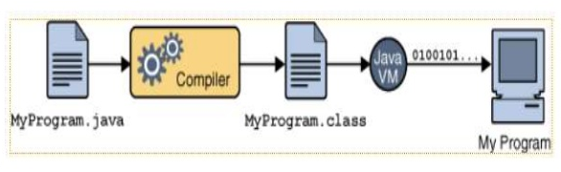
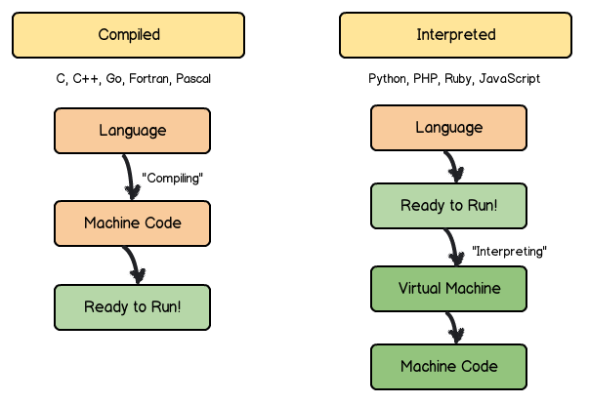
Java basics
general description
Name of the program
Why Write Once, Run Anywhere (WORA)?
This has to do with the fact that Java is an interpreted language, not a compiled one!!

Slide 12
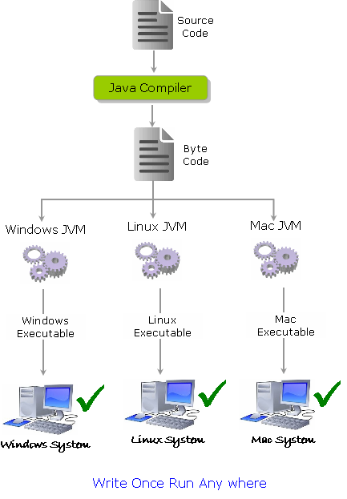
Java basics
general description
Name of the program

Slide 13
Java syntax foundations
Primitive data types and variables
Name of the program
Primitive data types are the minimum data abstraction in a programming language. This means they are predefined by the language (not by any API library); thus there is no method defined for any of them. It is just a plain data storage. In Java we have 8 of this primitives: boolean, char, byte, short, int, long, float and double. Java uses keywords, so that the IDE usually marks them up differently from the rest.
These basic (or primitive) types are the only types that are not objects.
So, for instance, you DO NOT use the new operator to create a primitive variable.
e.g.:
float initVal;
int retVal, index = 2;
double gamma = 1.2;
boolean valueOk = false;
If no value is assigned prior to use, then the compiler will give an error.
Java sets primitive variables to zero or false in the case of a boolean variable.
All object references are initially set to null.
An array on anything is an object:
Set to null on declaration.
Elements to zero false or null on creation.

Slide 14
Java syntax foundations
Primitive data types and variables
Name of the program
e.g.:
int index = 1.2; // compiler error
boolean retOk = 1; // compiler error in Java
double fiveFourths = 5/4; // no error!
float ratio = 5.8f; // correct
double fiveFourths = 5.0/4.0; // correct
All Java assignments are right associative
int a = 1, b = 2, c = 5;
a = b = c;
System.out.println(“a = ” + a + “, b = ” + b + “, c = ” c);
// What is the value of a, b & c?!
* / % + - are the mathematical operators. * / % have a higher precedence than + or -
double myVal = a + b % d - c * d / b;

Slide 15
Java syntax foundations
Primitive-wrappers
Name of the program
Java provides Objects which wrap primitive types and supply methods.
e.g.:
Integer n = new Integer(“4”);
int m = n.intValue();
It can be understood as advanced primitives, in the sense that it provides extra features to the regular primitives.
Just mention Byte, Short, Integer, Long, Float, Double, Character, Boolean.

Slide 16
Java syntax foundations
Blocks and flow of control
Name of the program
A block is a compound statement enclosed in curly brackets:
{
name1 = “Fred”; name2 = “Bill”;
}
Java executes one statement after the other in the order they are written.
Many Java statements are flow control statements:
Alternation => if, if else, switch.
Looping => for, while, do while.
Escapes => break, continue, return;
It is common to use relational operators such as: ==, !=, >=, <=, >, <.

Slide 17
Java syntax foundations
Blocks and flow of control
Name of the program
e.g.:
for (int i = 0; i < maxID, i++)
{
for (int j = 1; j > minID, j--)
{
if (userID[j] == targetID[i])
{
index--;
break;
}
else if (userID[j] == targetID[i + 1])
continue;
else
index++;
}
}
Can you predict what break and continue will do?

Slide 18
Java syntax foundations
Arrays
Name of the program
An array is a list of similar things which has a fixed name, type and length.
All these must be declared when the array is created.
Arrays sizes can not be changed during the execution of the code.
In Java, array indices start at 0.
To declare an array:
int myArray[]; //declares myArray to be an array of integers
myArray = new int[8]; //sets up 8 integer-sized spaces in memory
//------------------ OR
int myArray[] = new int[8]; //combining the two lines
int myArray[] = {3, 6, 3, 1, 6, 3, 4, 1}; // can create and initialise in one step
Remember that you Java also allows to create arrays of objects.
private Student studentList[];
studentList = new Student[10];
studentList[0] = Student(“Cathy”, “Computing”);

Slide 19
Java methods and classes
Name of the program
Following the OOP paradigm, a class is the way Java refers to objects. So, from now onwards, object == class*.
Each class definition is coded in a separate .java file. The Name of the object (class) file MUST match the class (object) name.
A class describes some data object(s) (attributes), and the operations (or methods) that can be applied to those objects.
Every object and method in Java belongs to a class.
Classes have data (fields) and code (methods) and classes (member classes or inner classes).
A method is a named sequence of code that can be invoked by other Java code.
A method takes some parameters, performs some computations and then optionally returns a value (or object).
A method signature specifies: the name of the method, the type and name of each parameter, the type of the value (or object) returned by the method, various methods modifiers and the checked exceptions thrown by the method.
public float convertCelsius(float tCelsius) {} throws IndexOutOfBoundsException() {}
Q: Can you make therefore the difference between an object and an instance of the object?
* Remember this is not a very formal statement. It is easier to thin this way, but do not make it a fact.

Slide 20
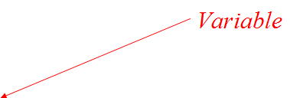

Java methods and classes
Name of the program
We can say that an object is a generic and abstract element, whereas a class defines the attributes and services of a particular type of object.
e.g.:
class Person
{
String name;
int age;
void birthday ()
{
age++;
System.out.println(name + “ is now “ + age);
}
}
In general, a class declaration must follow:
[class modifiers] class className{ [class definition] }

Slide 21
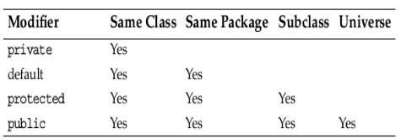
Java methods and classes
Name of the program
Class modifiers affect classes runtime behaviour. Different types apply:
Access modifiers: public, protected, and private.
Modifier requiring override: abstract.
Modifier restricting to one instance: static
Modifier prohibiting value modification: final.
Modifier forcing strict floating point behaviour: strictfp.
Annotations: e.g. @Override
Not all modifiers are allowed on all classes. For instance, an interface can not be final, in the same way a private outer-class does not make sense since it is not accessible from any other class, but a private constructor is possible and makes sense if you just have a class full of static variables and methods. Things might not make sense at first glance, but there might be something under the carpet.

Slide 22
Java methods and classes
Some static statements...
Name of the program
A static variable is also called a class variable, because all instances of the class share the same copy of the variable. A class variable can be accessed directly with the class, without the need to create an instance (But remember to make it public as well if you want to access them from another class!!).
Without the static keyword, it is called instance variable.
static variables are initialized only once, at the start of the execution. These variables will be initialized first, before the initialization of any instance variables.
A single copy to be shared by all instances of the class.
A static method belongs to the class and not to the object instance.
It can only access static data.
A static method can call only other static methods and can not call a non-static method from it.
A static method can be accessed directly by the class name and does not need any instance.
A static method can not refer to this or super keywords in anyway.

Slide 23
Java methods and classes
Some public/private statements...
Name of the program
Methods/data may be declared public or private meaning they may or may not be accessed by code in other classes.
Good practice:
Keep data private.
Keep most methods private/public.
Remember that a well-defined interface between classes helps to eliminate errors.
The ‘dot’ operator allows you to access data/methods if...
Fruit plum = new Fruit();
int cals;
cals = plum.total_calories();

Slide 24
Java methods and classes
Some final statements...
Name of the program
You can declare some or all of a class’s methods final.
You use final in a method declaration to indicate that the method can not be overriden (when inherited) by subclasses.
You might wish to make a method final if it has an implementation that should not be changed and it is critical to the consistent state of the object. For example, when playing chess:
class ChessAlgorithm
{
enum ChessPlayer { WHITE, BLACK }
...
final ChessPlayer getFirstPlayer()
{
return ChessPlayer.WHITE;
}
...
}
Methods from constructors should generally be declared final. If a constructor calls a non-final method, a subclass may redefine that method with undesirable results.
A class declared final cannot be subclassed.

Slide 25
Java methods and classes
Some abstract statements...
Name of the program
A class declared abstract may or may not include abstract methods; abstract classes can not be instantiated, but they can be subclassed.
An abstract method is declared without an implementation (without braces, and followed by a semicolon):
abstract void moveTo(double deltaX, double deltaY);
If a class includes abstract methods, then the class itself must be declared abstract.
When an abstract class is subclassed, the subclass usually provides implementations for all the abstract methods in its parent class. However, if it does not, then the subclass must also be declared abstract.
An abstract variable/data is not allowed.

Slide 26
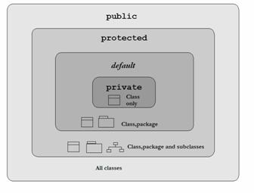
Java methods and classes
Modifiers summary...
Name of the program
Access modifiers:

Slide 27
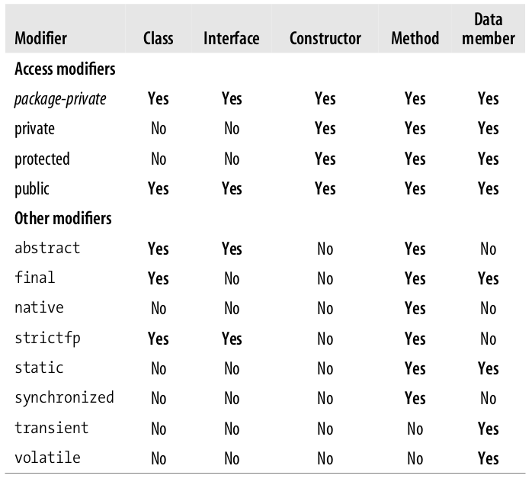
Java methods and classes
Modifiers summary...
Name of the program
In general, we can consider the following modifier availability table:

Slide 28
Java methods and classes
Constructors
Name of the program
Classes should define one or more methods to create or construct instances of the class.
Their name is the same as the class name (note deviation from convention that methods begin with lowercase)
Constructors are differentiated by the number and types of their arguments (overloading).
If you don’t define a constructor, a default one will be created with no arguments.
e.g.:
public class userProfile
{
private String profession;
public userProfile() { }; // this is optional
public userProfile(String mProfession) {
this.profession = mProfession; }
}

Slide 29
Java methods and classes
Constructors
Name of the program
As a rule of thumb, constructors of non-final classes should call only final or private methods. This applies to getter and setter methods, which are usually public. Java allows calling them from the constructor, but:
Those methods and any methods they may call must be careful not to assume the instance is fully initialized.
The subclasses that override those methods must not assume that the subclass constructor and superclasses’ constructors have been fully executed. Moreover, a user may override that public method causing some misbehaviour.
Constructors should be cautious about leaking this before the instance is fully initialized.
For this reason, variable assignments are usually made directly inside the constructor (dot operator).

Slide 30
The Java 4
Name of the program
In general, there are 4 fundamental OOP concepts that Java possesses, which are:
Abstraction
Encapsulation.
Inheritance
Polymorphism

Slide 31
The Java 4
Abstraction
Name of the program
In OOP, abstraction relates to the process of hiding the implementation details from the user; thus only the functionality will be provided to the user. In other words users will have the information on what the object does instead of how it does it.
In Java, abstraction is achieved by abstract classes and interfaces.
http://www.tutorialspoint.com/java/java_abstraction.htm

Slide 32
The Java 4
Abstraction: abstract classes
Name of the program
A class which contains the abstract keyword in its declaration is known as an abstract class.
Abstract classes may or may not contain abstract methods, i.e. methods without body [ public void get();].
But, if a class have at least one abstract method, then the class MUST be declared as abstract.
If a class is declared abstract it cannot be instantiated (same effect as when having a private constructor).
To use an abstract class you have to inherit it from another class, and provide implementations to the abstract methods in it. If you inherit an abstract class you have to provide implementations to ALL the abstract methods in it.

Slide 33
The Java 4
Abstraction: abstract classes
Name of the program
e.g.: follows the definition of an abstract class with no abstract methods
public abstract class Employee {
private String name;
private String address; private int number; public Employee(String name, String address, int number) {
System.out.println("Constructing an Employee");
this.name = name;
this.address = address;
this.number = number;
} public double computePay() { System.out.println("Inside Employee computePay"); return 0.0; }
}

Slide 34
The Java 4
Abstraction: abstract classes
Name of the program
The abstract class cannot be instantiated, but it can be inherited.
public class Salary extends Employee
{
private double salary; public Salary(String name, String address, int number, double salary)
{
super(name, address, number);
setSalary(salary);
} @Override public double computePay()
{
System.out.println("Computing salary pay for " + getName());
return salary/52;
} }
You cannot instantiate the Employee class, but you can instantiate the Salary Class, and thus access all the fields and methods of Employee class.

Slide 35
The Java 4
Abstraction: abstract classes
Name of the program
If you want a class to contain a particular method but you want the actual implementation of that method to be determined by child classes, you can declare the method in the parent class as abstract.
An abstract method contains a method signature, but no method body. Instead of curly braces an abstract method will have a semicolon at the end.
Declaring a method as abstract has two consequences:
The class containing it must be declared as abstract.
Any class inheriting the current class must either override the abstract method or declare itself as abstract.
Note that eventually, a descendant class has to implement the abstract method; otherwise, you would have a hierarchy of abstract classes that cannot be instantiated.

Slide 36
The Java 4
Abstraction: interfaces
Name of the program
An interface is a reference type in Java. It is similar to a class
Along with abstract methods an interface may also contain constants, default methods, static methods, and nested types. Method bodies exist only for non-abstract methods, obviously.
Writing an interface is similar to writing a class. But a class describes the attributes and behaviours of an object. And an interface contains behaviours that a class implements.
Unless the class that implements the interface is abstract, all the methods of the interface need to be defined in the class.
The interface keyword is used to declare an interface.
e.g.:
public interface NameOfInterface
{
// Any number of final, static fields // Any number of abstract method declarations }

Slide 37
The Java 4
Abstraction: interfaces
Name of the program
Interfaces have the following properties:
An interface is implicitly abstract. You do not need to use the abstract keyword while declaring an interface.
Each method in an interface is also implicitly abstract, so the abstract keyword is not needed.
Methods in an interface are implicitly public.
e.g.:
interface Animal
{
public void eat();
public void travel(); }
When a class implements an interface, you can think of the class as signing a contract, agreeing to perform the specific behaviors of the interface (i.e. overriding its methods). If a class does not perform all the behaviors of the interface, the class must declare itself as abstract.
A class uses the implements keyword to implement an interface, right after the extends portion.

Slide 38
The Java 4
Abstraction: interfaces
Name of the program
When overriding methods defined in interfaces there are several rules to be followed:
The signature of the interface method and the same return type or subtype should be maintained when overriding the methods (as usual for dynamic polymorphism).
An implementation class itself can be abstract and if so interface methods need not be implemented.
When implementation interfaces there are several rules:
A class can implement more than one interface at a time (We will do it a lot in Android).
A class can extend only one class, but implement many interfaces.
An interface can extend another interface, similarly to the way that a class can extend another class.
Note that a Java class can only extend one parent class; i.e. multiple inheritance is not allowed. Interfaces are not classes, however it can help to pretend/simulate multiple inheritance.

Slide 39
The Java 4
Abstraction: classes vs interfaces
Name of the program
An interface is similar to a class in the following ways:
An interface can contain any number of methods.
An interface is written in a file with a .java extension, with the name of the interface matching the name of the file.
The byte code of an interface appears in a .class file.
Interfaces appear in packages, and their corresponding bytecode file must be in a directory structure that matches the package name.
However, an interface is different from a class in several ways, including:
You cannot instantiate an interface.
An interface does not contain any constructors.
All of the methods in an interface are abstract.
An interface cannot contain instance fields. The only fields that can appear in an interface must be declared both static and final.
An interface is not extended by a class; it is implemented by a class.
An interface can extend multiple interfaces.

Slide 40
The Java 4
Abstraction: abstract classes vs interfaces
Name of the program
Here are some guidelines on when to use an abstract class and when to use interfaces in Java:
An abstract class is good if you think you will plan on using inheritance since it provides a common base class implementation to derived classes.
An abstract class is also good if you want to be able to declare non-public members. In an interface, all methods must be public.
If you think you will need to add methods in the future, then an abstract class is a better choice. Because if you add new method headings to an interface, then all of the classes that already implement that interface will have to be changed to implement the new methods. That can be quite a hassle.
Interfaces are a good choice when you think that the API will not change for a while.
Interfaces are also good when you want to have something similar to multiple inheritance, since you can implement multiple interfaces.
As a rule of thumb, we use abstract classes when there is a strong relationship between that class and the one which is going to inherited it. Otherwise, interfaces are a better choice.

Slide 41
The Java 4
Abstraction: abstract classes vs interfaces
Name of the program
Just an example about when is convenient to go for abstract classes:
public abstract class Figure { public abstract float getArea(); } public class Circle extends Figure { private float radius; public float getArea() { return (3.14 * (radius ^ 2)); } } public class Rectangle extends Figure { private float length, width; public float getArea(Figure other) { return length * width; } }
why did we declare the getArea method to be abstract in the Figure class?

Slide 42
The Java 4
Abstraction: abstract classes vs interfaces
Name of the program
e.g. cont.:
public class myMain
{
public static void main(String[] args)
{
Figure f1 = new Circle(4.0) // A constructor is assumed
Figure f2 = new Rectangle(1.0, 2.6) // idem
System.out.println(“Area1 = ” +
Float.toString(f1.getArea) + “, Area2 = ” +
Float.toString(f2.getArea));
}
}
Doing so we can create an array of datatype Figure, even this being abstract.

Slide 43
The Java 4
Encapsulation
Name of the program
Encapsulation in Java is a mechanism of wrapping the data (variables) and code acting on the data (methods) together as a single unit.
In encapsulation the variables of a class will be hidden from other classes, and can be accessed only through the methods of their current class, therefore it is also known as data hiding.
To achieve encapsulation:
Declare the variables of a class as private.
Provide public setter and getter methods to modify and view the variables values.
Benefits of encapsulation are:
The fields of a class can be made read-only or write-only.
A class can have total control over what is stored in its fields.
The users of a class do not know how the class stores its data. A class can change the datatype of a field and users of the class do not need to change any of their code.
http://www.tutorialspoint.com/java/java_encapsulation.htm

Slide 44
The Java 4
Inheritance
Name of the program
Java classes can be derived from other classes, thereby inheriting fields and methods from those classes.
Def.:
A class that is derived from another class is called a subclass (derived class, or child class). The class from which the subclass is derived is called a superclass (base class or parent class).
Every Java class has one and only one direct superclass (single inheritance), since every class is implicitly a subclass of Object. There is one only exception…
Classes can be derived from classes that are derived from classes that are derived from classes… but only one inheritance is allowed at a time.
Why is inheritance so important?
When you want to create a new class and there is already a class that includes some of the code you want, you can simply derive your new class from the existing class. Thus you can reuse fields and methods of the existing class.
The keyword extends expresses that a class is derived from a particular existing class.
https://docs.oracle.com/javase/tutorial/java/IandI/subclasses.html

Slide 45
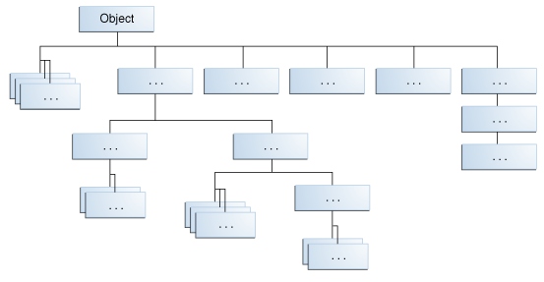
The Java 4
Inheritance
Name of the program
At the top of the hierarchy, Object is the most general of all classes. Classes near the bottom of the hierarchy provide more specialized behavior.
https://docs.oracle.com/javase/tutorial/java/IandI/subclasses.html

Slide 46
The Java 4
Inheritance
Name of the program
e.g.:
public class Bicycle
{
public int cadence;
public int gear;
public int speed;
public Bicycle(int startCadence, int startSpeed, int startGear)
{
gear = startGear; cadence = startCadence; speed = startSpeed;
}
public void applyBrake(int decrement)
{ speed -= decrement; }
}

Slide 47
The Java 4
Inheritance
Name of the program
e.g.:
public class MountainBike extends Bicycle
{
public int seatHeight;
public MountainBike(int startHeight, int startCadence, int startSpeed, int startGear)
{
super(startCadence, startSpeed, startGear);
seatHeight = startHeight;
}
public void setHeight(int newValue)
{ seatHeight = startHeight; }
}
MountainBike inherits all the fields and methods of Bicycle and adds the field seatHeight and a setter.

Slide 48
The Java 4
Inheritance: What you can do in a subclass
Name of the program
A subclass inherits all of the public and protected members of its parent, no matter what package the subclass is in.
If the subclass is in the same package as its parent, it also inherits the package-private members of the parent. Some comments follow:
The inherited fields can be used directly, just like any other fields.
You can declare a field in the subclass with the same name as the one in the superclass, thus hiding it (not recommended).
You can declare new fields in the subclass that are not in the superclass.
The inherited methods can be used directly as they are.
You can write a new instance method in the subclass that has the same signature as the one in the superclass, thus overriding it.
You can write a new static method in the subclass that has the same signature as the one in the superclass, thus hiding it.
You can declare new methods in the subclass that are not in the superclass.
You can write a subclass constructor that invokes the constructor of the superclass, either implicitly or by using the keyword super.
https://docs.oracle.com/javase/tutorial/java/IandI/subclasses.html

Slide 49
The Java 4
Inheritance: What you can do in a subclass
Name of the program
Let’s clarify some aspects just mentioned:
A subclass DOES NOT inherit the private members of its parent class. However, if the superclass has public or protected methods for accessing its private fields (think of getters and setters), these can be used by the subclass.
A nested class has access to all the private members of its enclosing class (both fields and methods). Therefore, a public or protected nested class inherited by a subclass has indirect access to all of the private members of the superclass.
In our example a MountainBike instance descends from Bicycle and Object. Therefore, a MountainBike is a Bicycle and is also an Object*, and it can be used wherever Bicycle or Object objects are called for.
Casting shows the use of an object of one type in place of another type. This can be done:
Object obj = new MountainBike(); // implicit casting
MountainBike myBike = (MountainBike) obj; // explicit casting
* The reverse is not necessarily true.
https://docs.oracle.com/javase/tutorial/java/IandI/subclasses.html

Slide 50
The Java 4
Polymorphism
Name of the program
In biology, polymorphism refers to a principle in which an organism or species can have many different forms or stages.
In OOP languages, subclasses of a class can define their own unique behaviours and yet share some of the same functionality of the parent class. Thus polymorphism describes a language’s ability to process objects of various types and classes through a single, uniform interface.
Polymorphism in Java has two types: Compile-time polymorphism (static binding) and Runtime polymorphism (dynamic binding). Method overloading is an example of static polymorphism, while method overriding is an example of dynamic polymorphism.
http://www.sitepoint.com/quick-guide-to-polymorphism-in-java/

Slide 51
The Java 4
Polymorphism: Static binding
Name of the program
Static polymorphism is achieved through method overloading, which means there are several methods present in a class having the same name but different types/order/number of parameters (just think of constructors!).
At compile-time, Java knows which method to invoke by checking the method signatures.
e.g.:
class DemoOverload
{
public int add(int x, int y) { return x + y; }
public int add(int x, int y, int z){ return x + y + z; }
}
class Test
{
public static void main(String[] args)
{
DemoOverload demo = new DemoOverload();
System.out.println(demo.add(2, 3));
System.out.println(demo.add(2, 3, 4))
}
}
http://www.sitepoint.com/quick-guide-to-polymorphism-in-java/

Slide 52
The Java 4
Polymorphism: Dynamic binding
Name of the program
Let’s suppose a subclass overrides a particular method of the superclass.
class Vehicle
{
public void move()
{ System.out.println(“Vehicles can move!!”); }
} class MotorBike extends Vehicle
{ @Override
public void move()
{ System.out.println(“MotorBike can move and accelerate too!!”); }
}
class Test
{
public static void main(String[] args)
{
Vehicle vh = new MotorBike();
vh.move();
vh = new Vehicle();
vh.move();
}}
http://www.sitepoint.com/quick-guide-to-polymorphism-in-java/

Slide 53
The Java 4
Polymorphism: Dynamic binding
Name of the program
The benefit of dynamic polymorphism (annotation @Override) is the ability to define a behaviour that is specific to the subclass type which means a subclass can implement a parent class method based on its requirement.
In object-oriented terms, overriding means to override the functionality of an EXISTING method; i.e. overrided methods have exactly the same signature as the one in the superclass.
Some comments about overriding:
The access level cannot be more restrictive than the overridden method's access level. For example: if the superclass method is declared public then the overridding method in the sub class cannot be either private or protected.
A method declared final cannot be overridden.
If a method cannot be inherited, then it cannot be overridden (think of private methods).
A subclass within the same package as the instance's superclass can override any superclass method that is not declared private or final.
A subclass in a different package can only override the non-final methods declared public or protected.
Constructors cannot be overridden.
http://www.tutorialspoint.com/java/java_overriding.htm
http://www.tutorialspoint.com/java/java_polymorphism.htm

Slide 54
Java stream manipulation
Name of the program
Basic classes for file IO
FileInputStream, for reading from a file.
FileOutputStrem, for writing to a file.
e.g:
// Open file for reading
FileInputStream fis = new FileInputStream(“myfile.txt”);
// Open file for writing
FileOutputStream fos = new FileOutputStream(“myfile.txt”);
Once the stream (e.g. file) has been opened, we can attach filters.
Filters make reading/writing more efficient. Among the most popular we have:
DataInputStream and DataOutputStream for basic types.
ObjectInputStream and ObjectOutputStream for objects.

Slide 55
Review of learning aspects
MDSD - Android
What we have learnt so far?
This Java development lesson intended to provide the student with solid foundations so that Android development becomes more easily affordable.
Main aspects of Java have been reviewed and examined, such as abstraction, inheritance, encapsulation, and polymorphism.
Notes:
Welcome back!
Ready for the second day of the Lean IT Foundation
Check if the students are ready to start

Slide 56


MDSD - Android
© 2016, Barcelona Technology School ed 1.0 13/01/2016
www.barcelonatechnologyschool.com

